Slide 1

Week 9 SafePath User Evaluation
Group 2
D24126339 – Huda Ibrahim - Team Lead
D24127853 – Hina Kausar
D24126048 – Shalini Kuruguntla
D24125575 – Sai Priyanka Basa Shanker
D24125555 – Karan Joseph

Slide 2
Project Overview
Goal: safety-first routing app for cyclists & pedestrians
Scope:
Safer alternative routes (crime, lighting, hazards)
Real-time hazard reporting
Find Buddy (community safety)
Notes:
SafePath is a safety-first navigation app designed for walkers and cyclists in urban environments (starting with London, UK).Unlike typical navigation tools that focus on speed, SafePath prioritizes personal safety helping users avoid unsafe or poorly lit areas.
The app recommends routes by analyzing:
Crime data and lighting conditions
User-reported hazards (e.g. blocked paths, unsafe crossings)
Community feedback from other SafePath users
Core features include Suggested Routes, Hazard Reporting, Find a Buddy.
The system continuously learns user preferences, tailoring route suggestions to individual risk tolerance and travel patterns.
Vision: build a trusted companion for everyday travel — promoting safer mobility, stronger community awareness, and informed urban design.

Slide 3
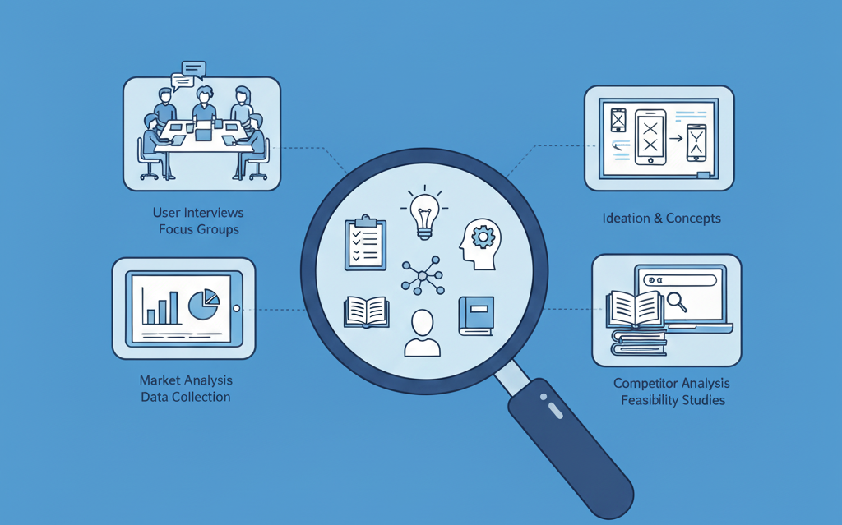
Phase #1 - Research Phase

Slide 4


Functional Requirements
Search walking & cycling routes with fastest + safest options
Find a buddy travelling a similar route
Sign up / log in, with securely saved credentials
Report issues or incidents along the route
See secure bike parking near destinations and along routes
Save preferences & favourites (e.g. avoid dark streets, prefer bike lanes)

Slide 5
Non-Functional Requirements
Readable & inclusive UI (clear fonts, high contrast)
Easy to navigate to support safe, confident use
Secure data storage compliant with GDPR
Scalable to other cities for future growth
Reliable & fast responses to user actions
Cross-platform support (iOS & Android)

Slide 6
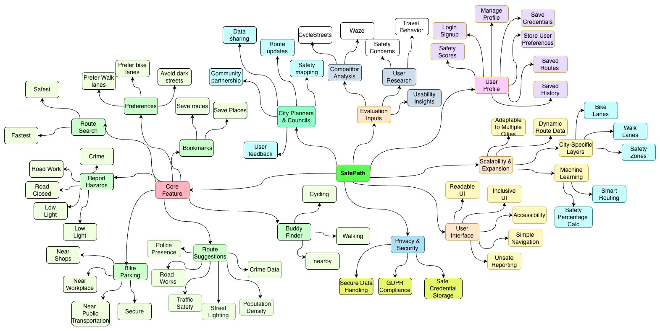
Concept Map

Slide 7
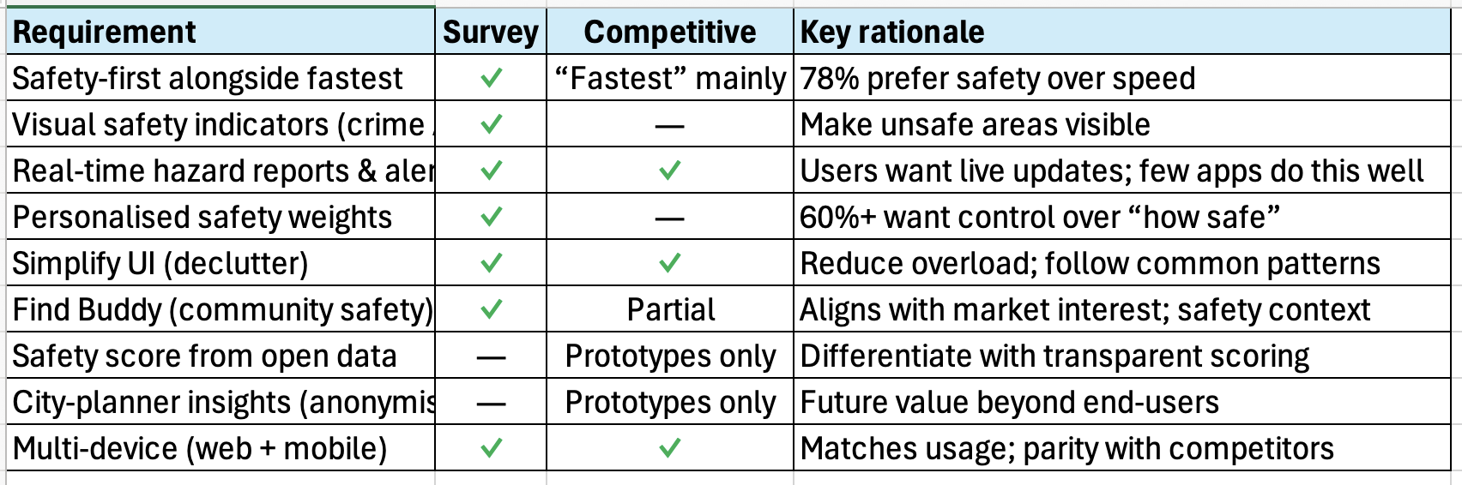
Research Mapping & Business Requirements

Slide 8
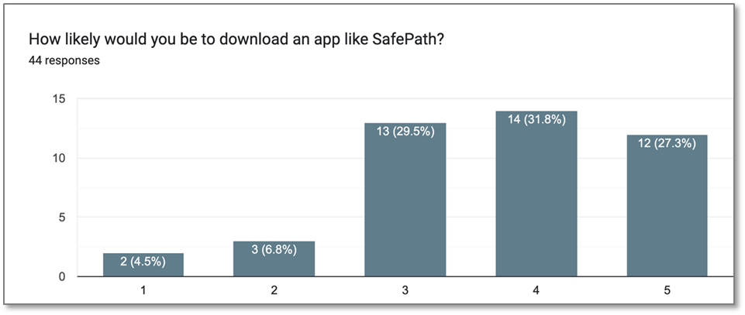
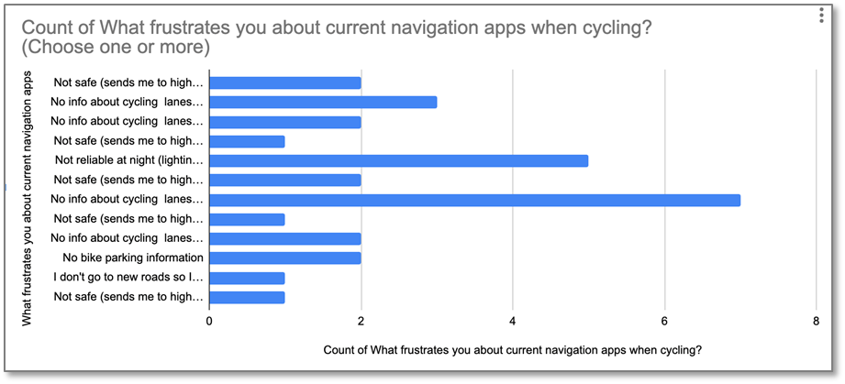
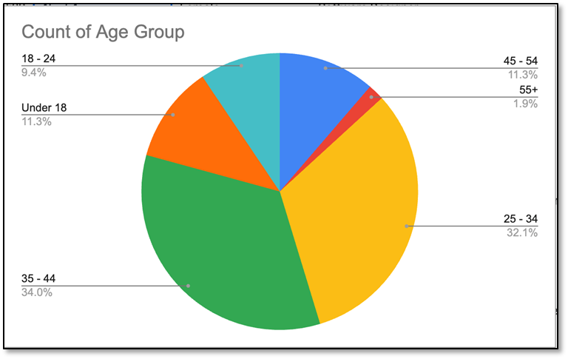
Field Research

Slide 9
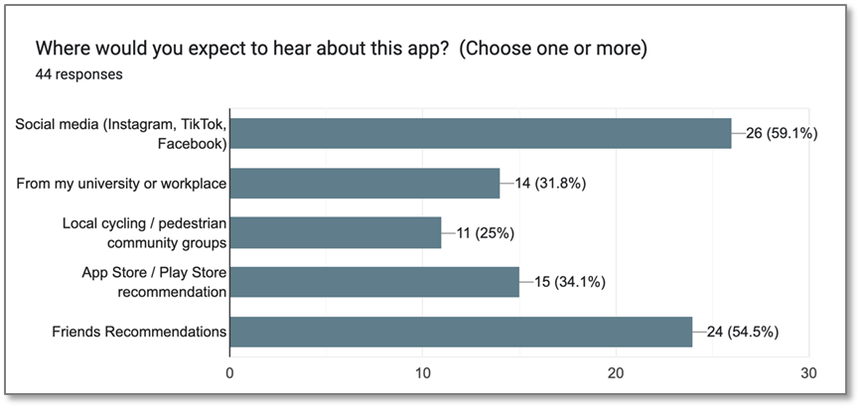
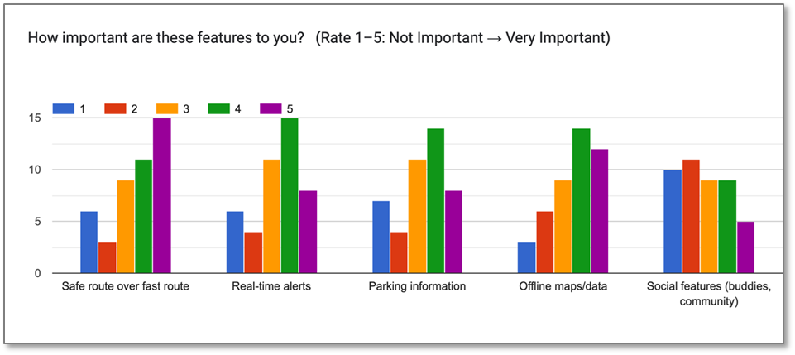
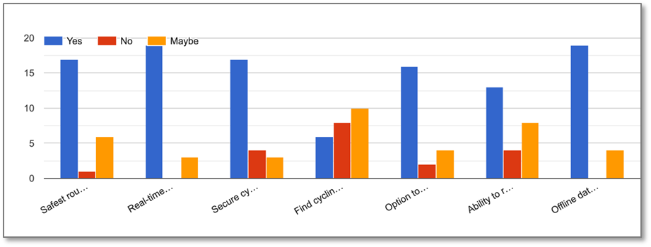
Field Research

Slide 10
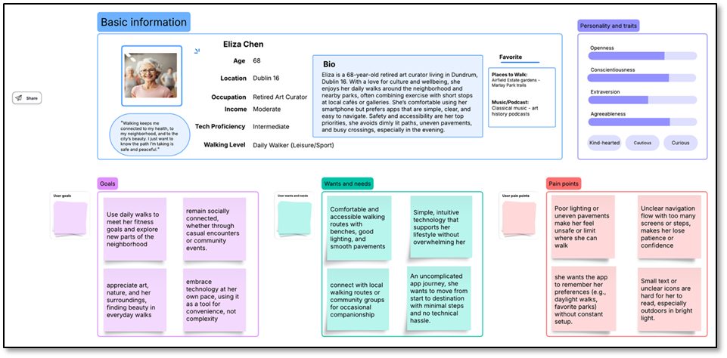
Personas Daily Walker

Slide 11
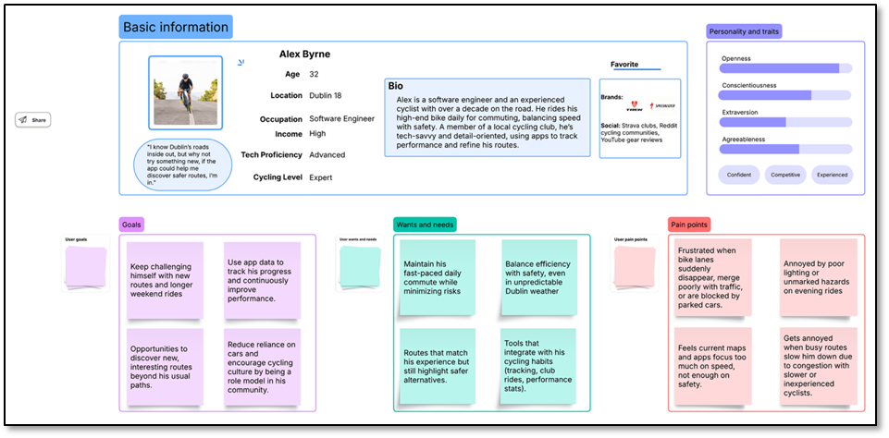
Personas Expert Cyclist

Slide 12
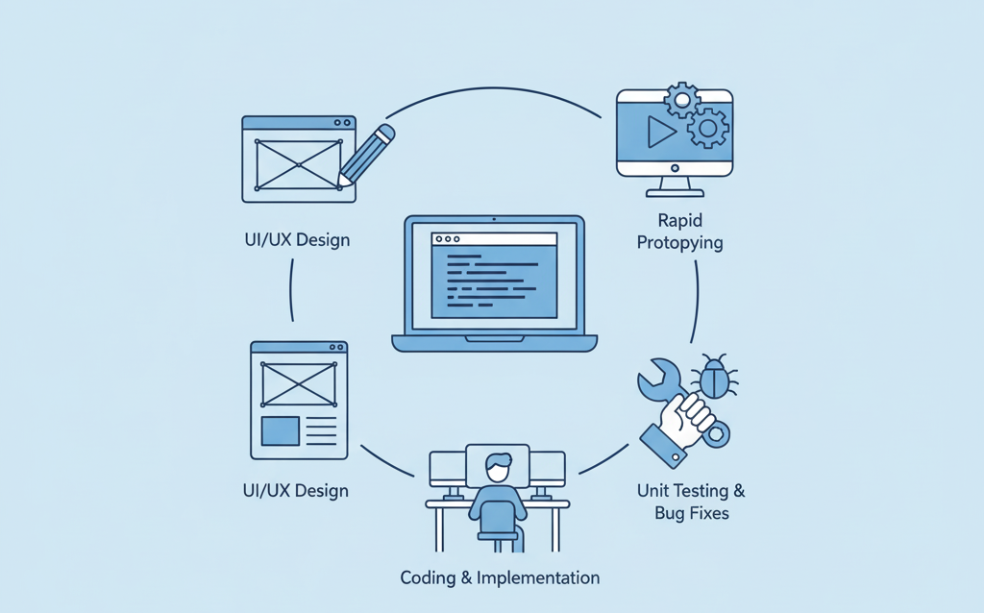
Phase #2 - Initial Development

Slide 13
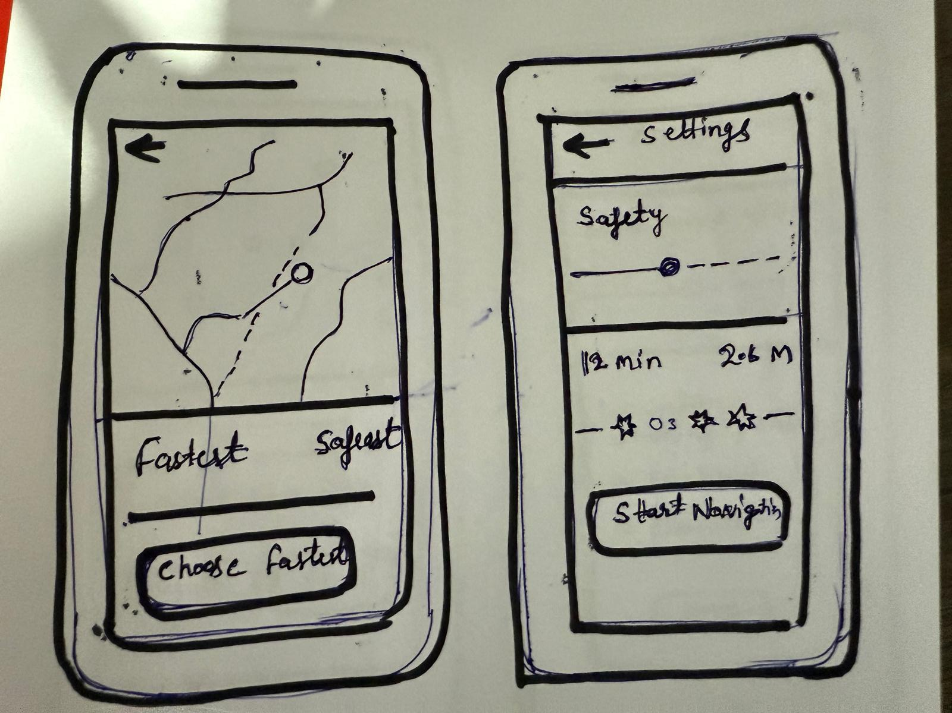
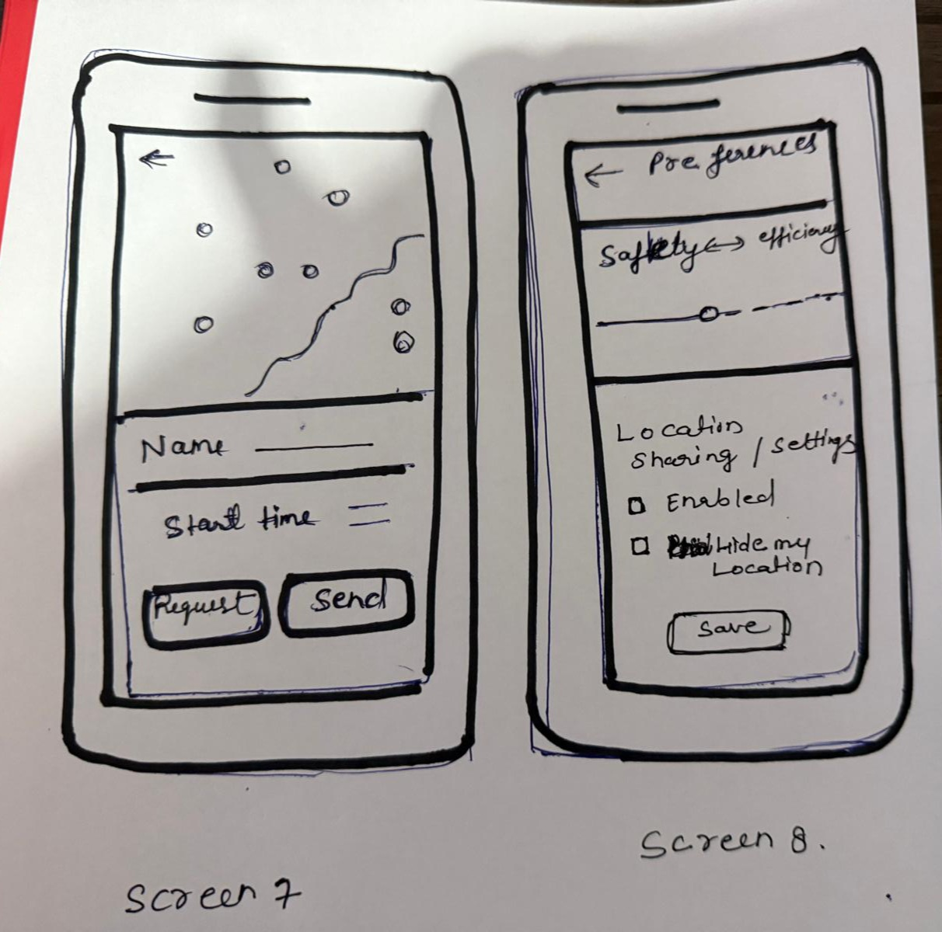
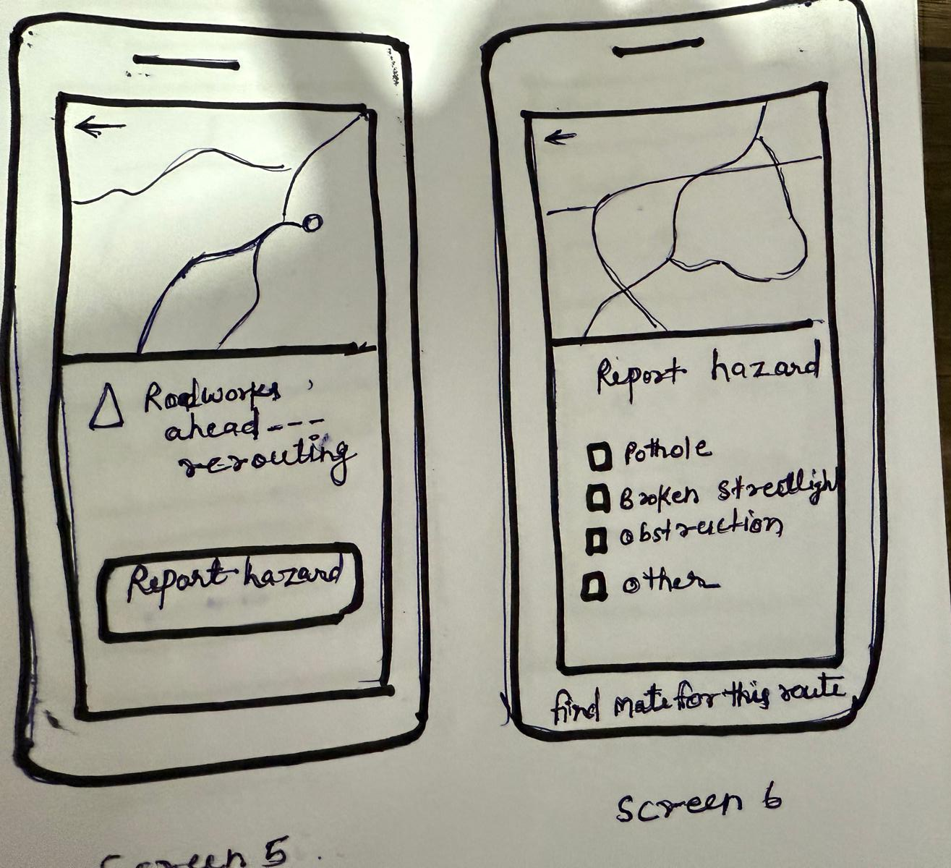
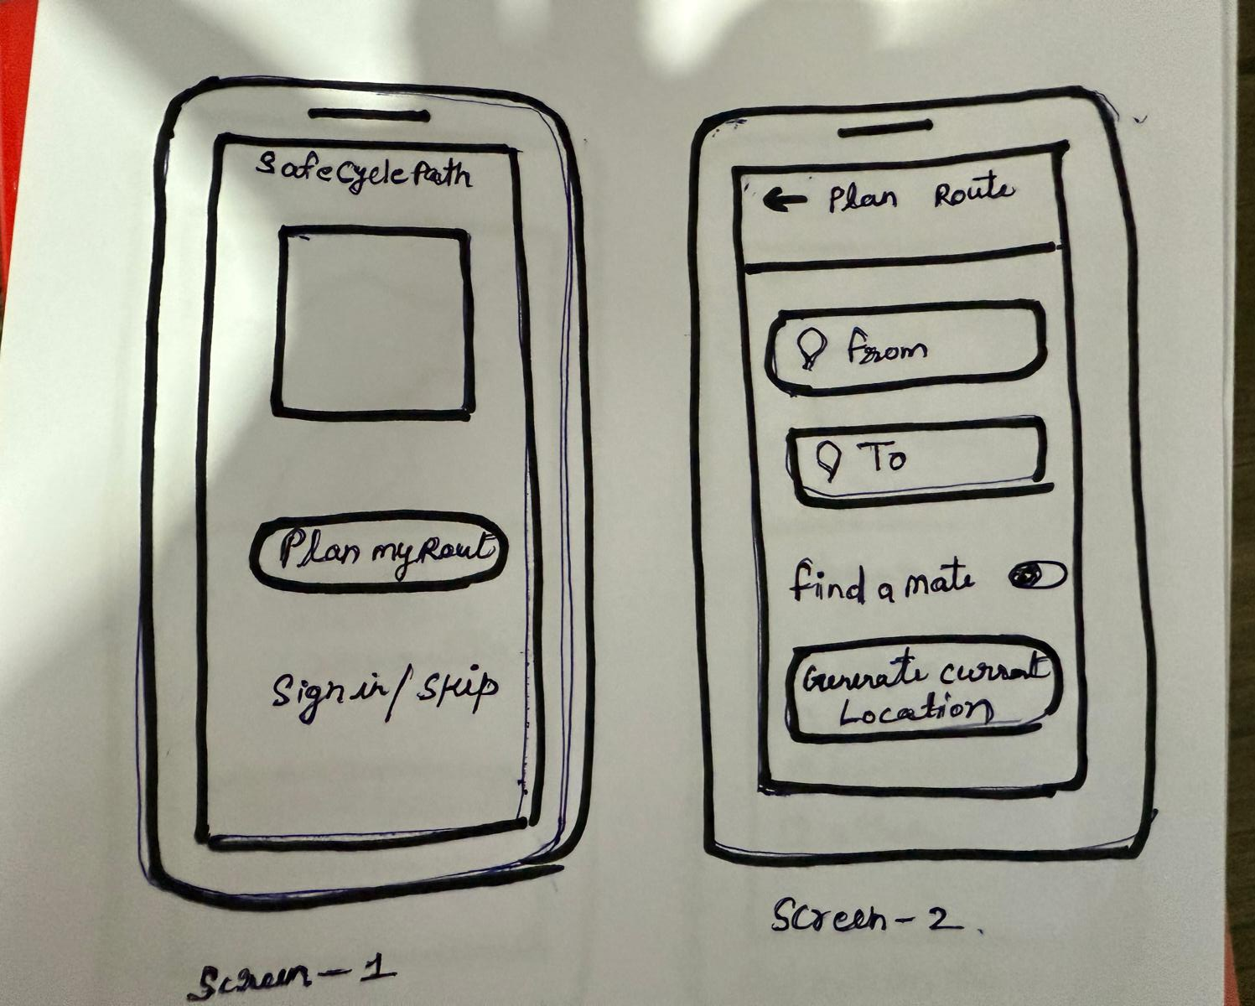
Low Fidelity Prototype

Slide 14
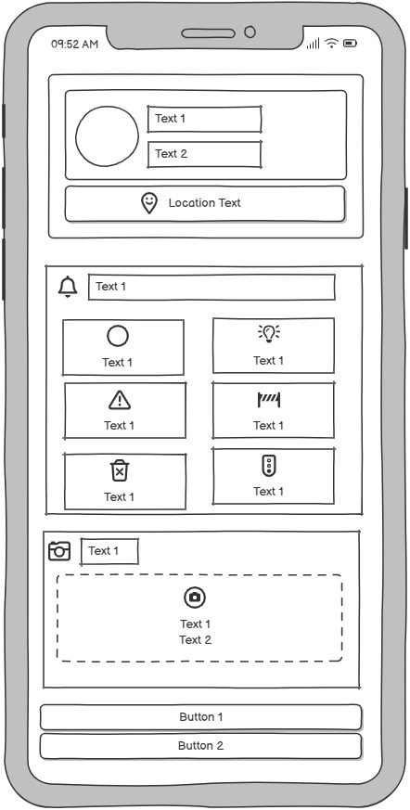
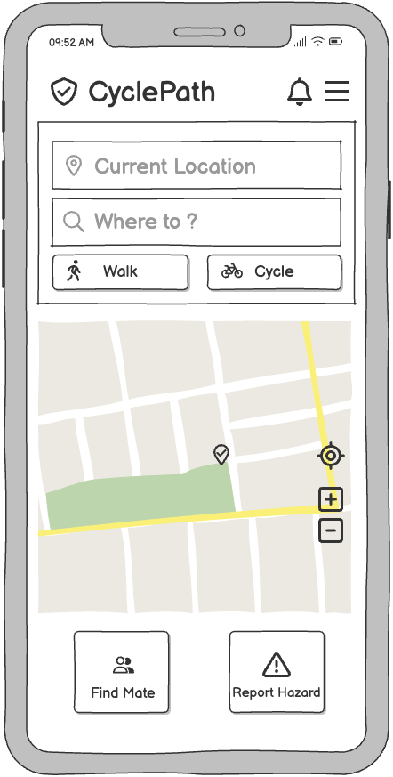
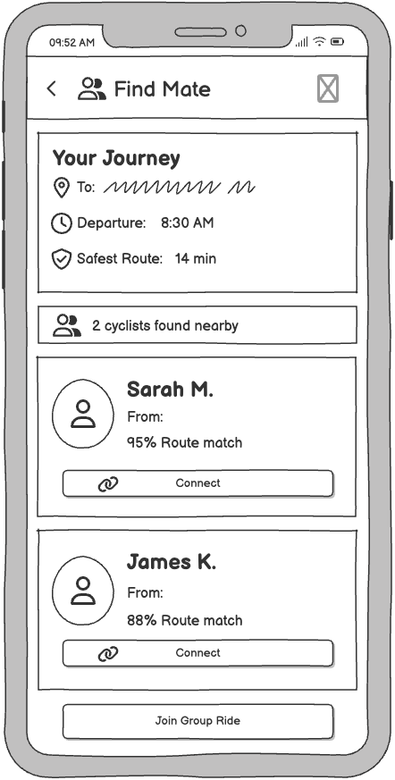
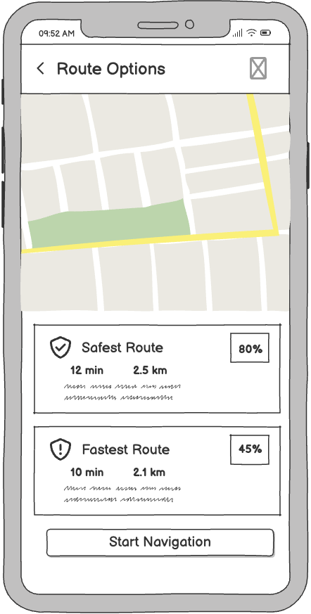
Wireframes

Slide 15
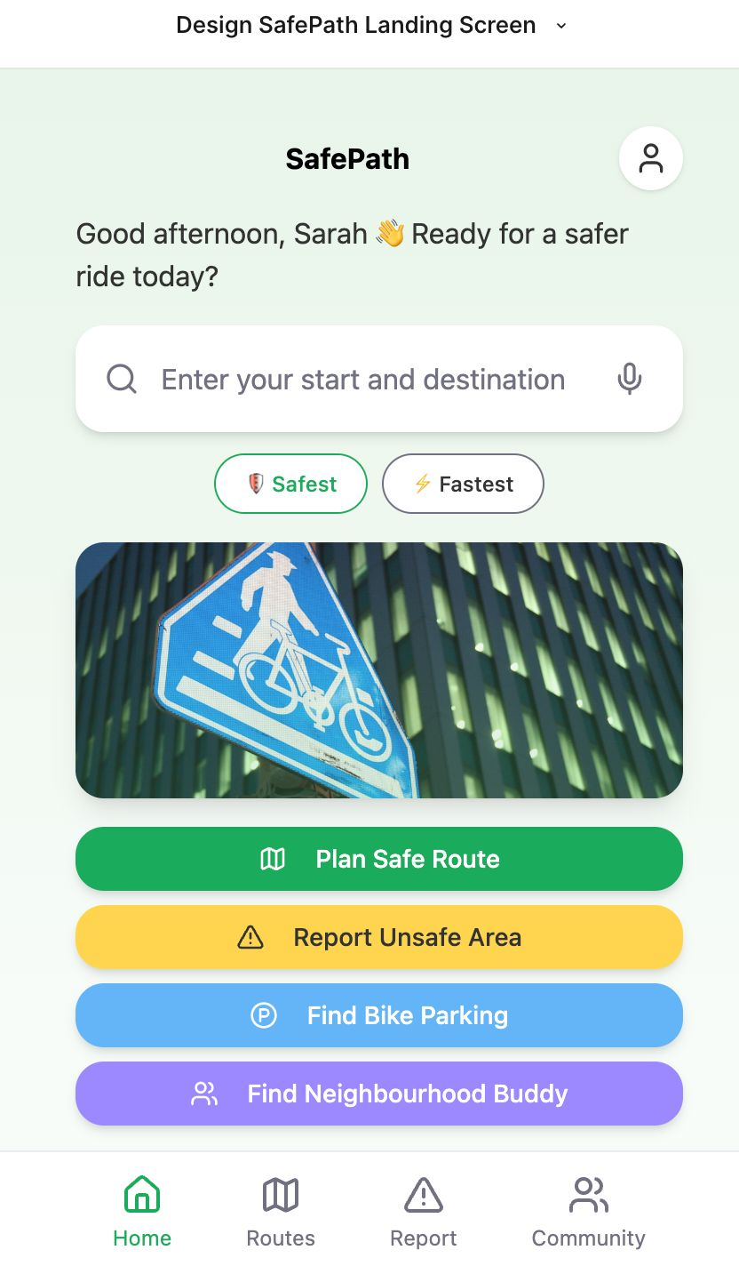
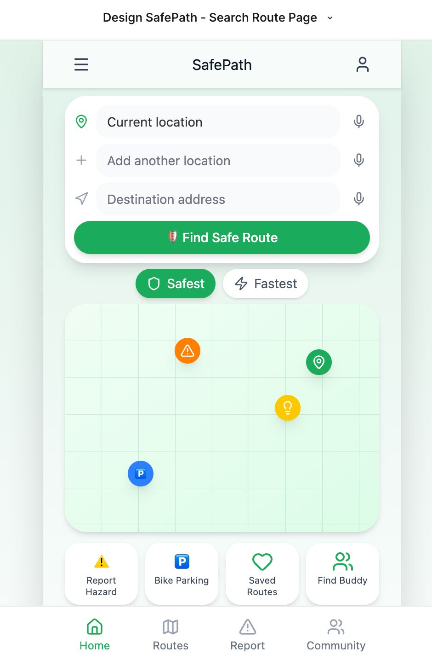
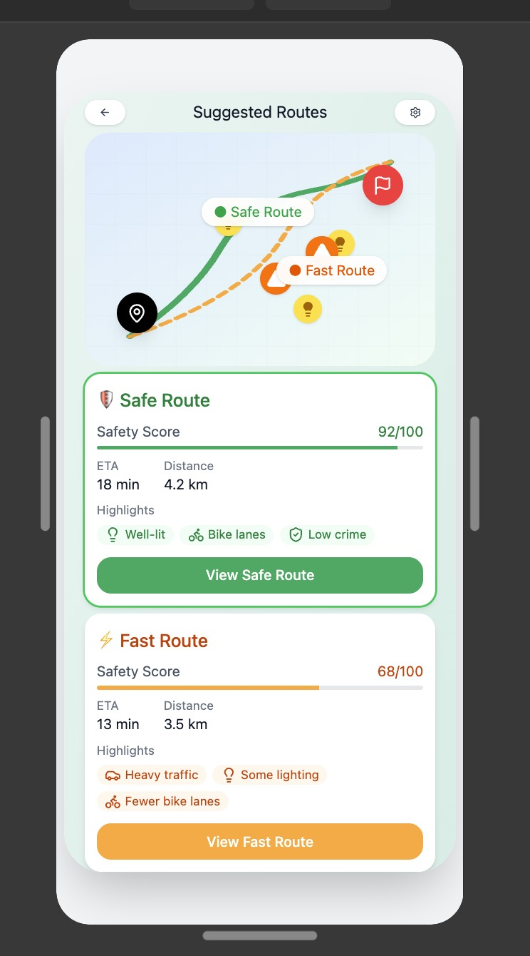
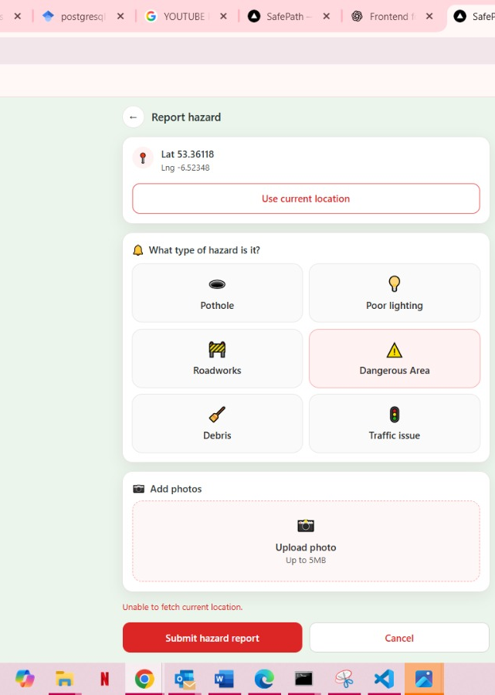
Medium Fidelity Prototype

Slide 16
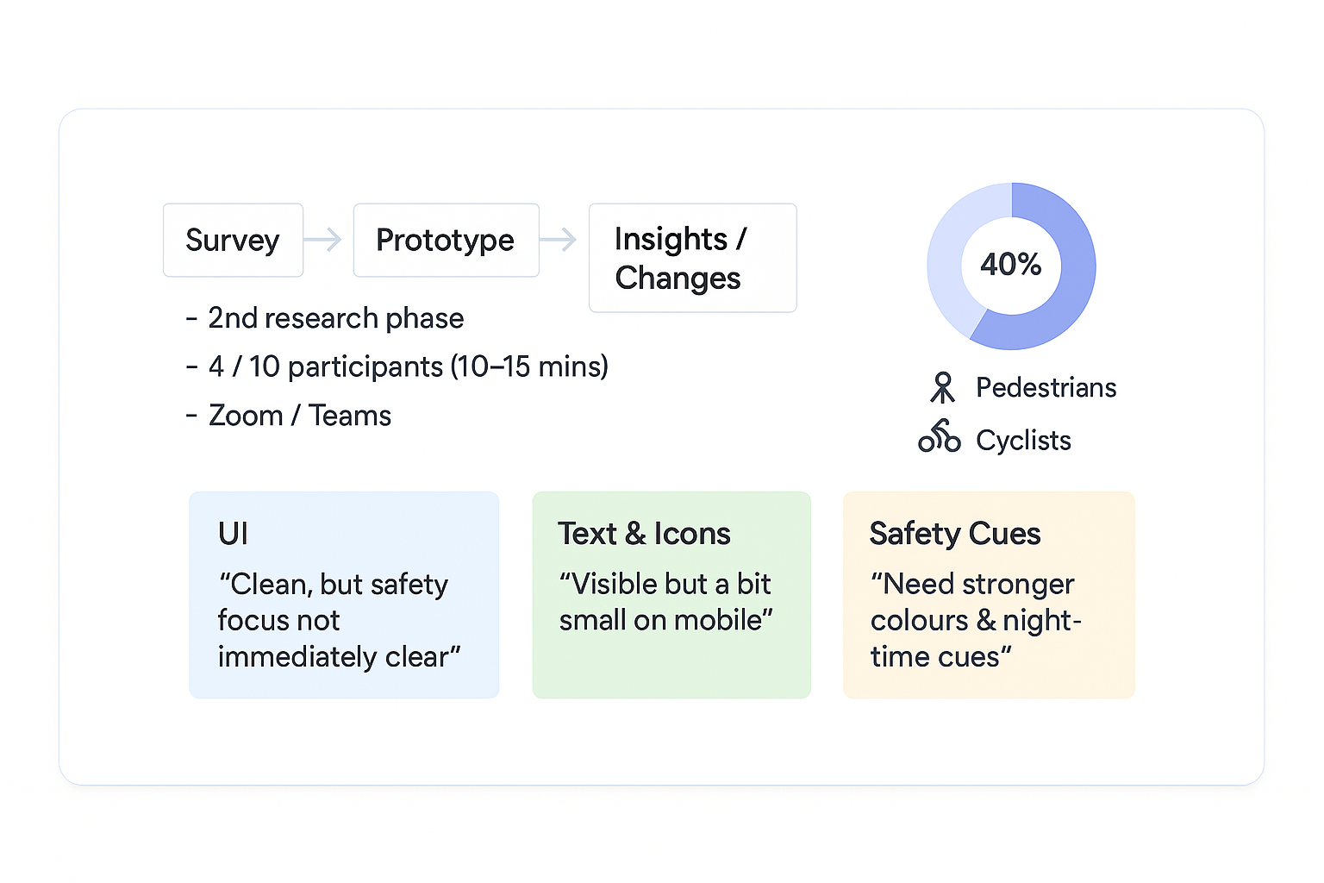
Prototype Interviews – Method & Early Insights

Slide 17
UX Principles & Heuristic Evaluation
Heuristic Principle | Observed Issue in SafePath Prototype | Severity (0–4)
Visibility of System Status | No loading indicator during route recalculation; users uncertain if map is updating | 2
Match Between System and Real World | Some icons (e.g., hazard vs. lighting) not immediately clear to first-time users | 3
User Control and Freedom | Once a hazard is reported, it cannot easily be undone or edited | 2
Consistency and Standards | Colour meanings for “safe” and “alert” routes not fully standardized | 1
Error Prevention | No confirmation after submitting a hazard, risking duplicate entries | 2
Recognition Rather Than Recall | Legend disappears on smaller screens, forcing recall | 3
Flexibility and Efficiency of Use | No quick access to recently searched routes | 1
Aesthetic and Minimalist Design | Map becomes cluttered when many overlays are active | 2
Help and Documentation | No quick-help or onboarding tip for first-time users | 3

Slide 18
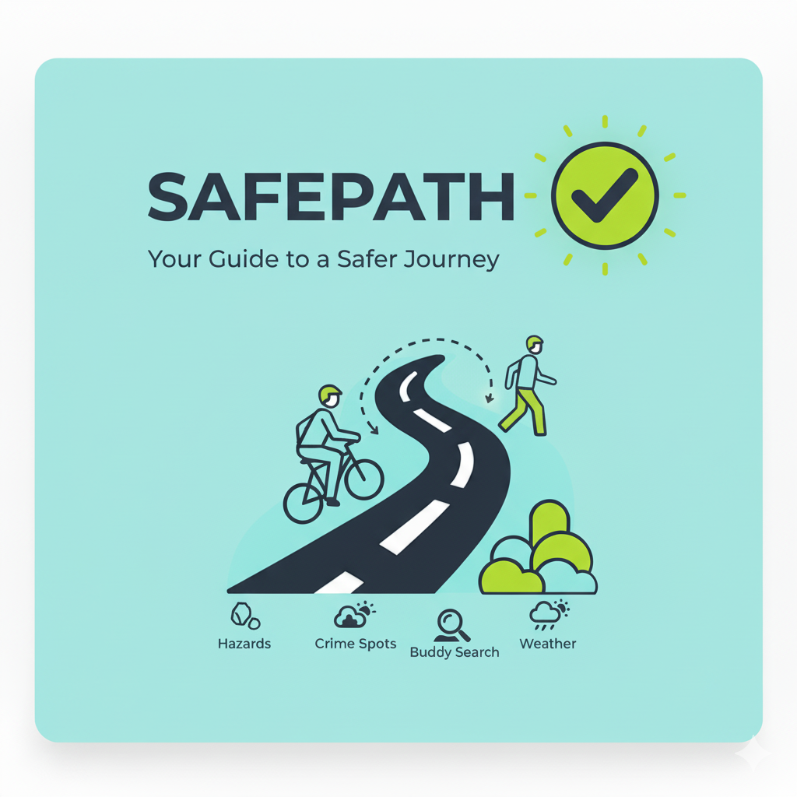
Phase #3 – Final App & Expert Review

Slide 19
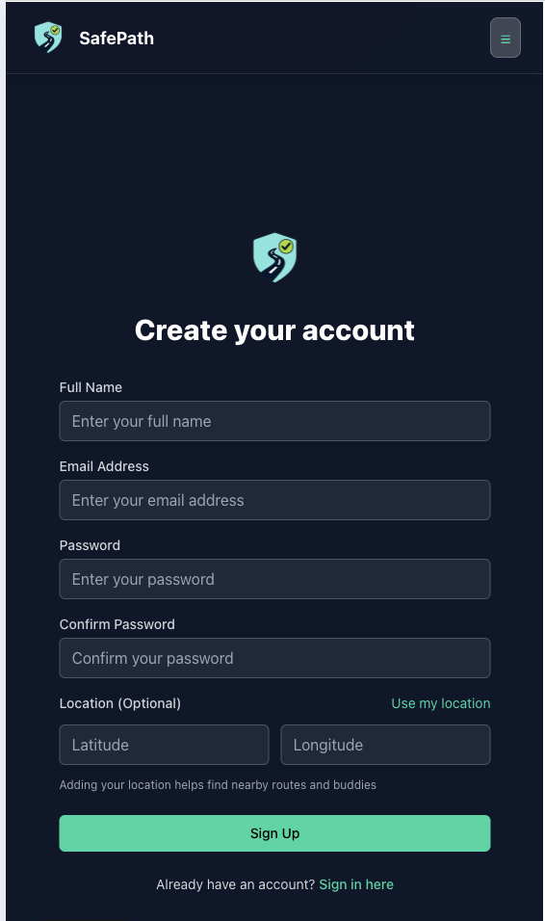
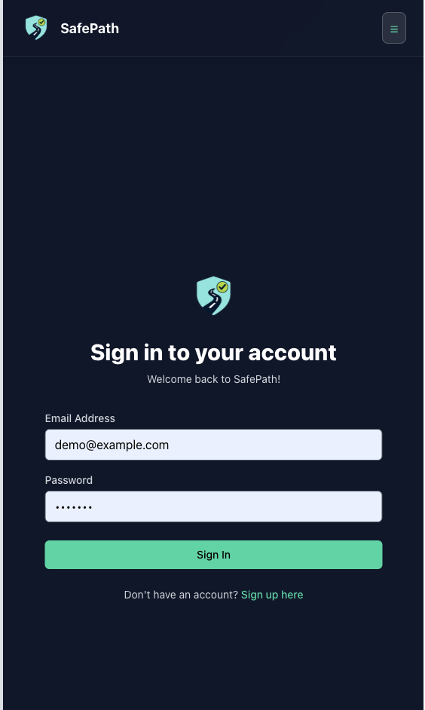
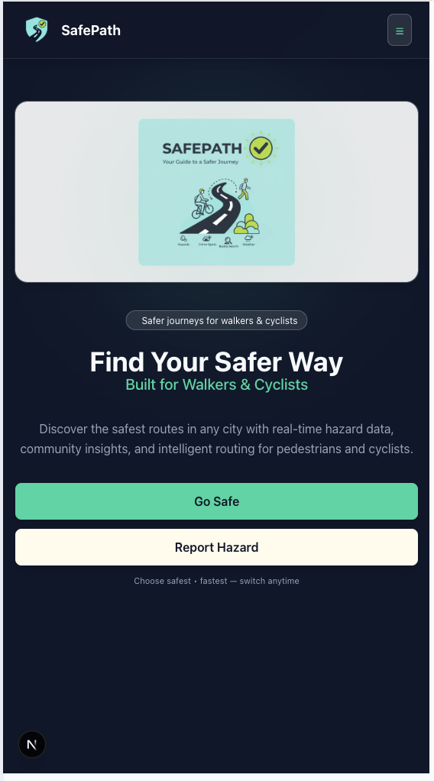
Final Application

Slide 20
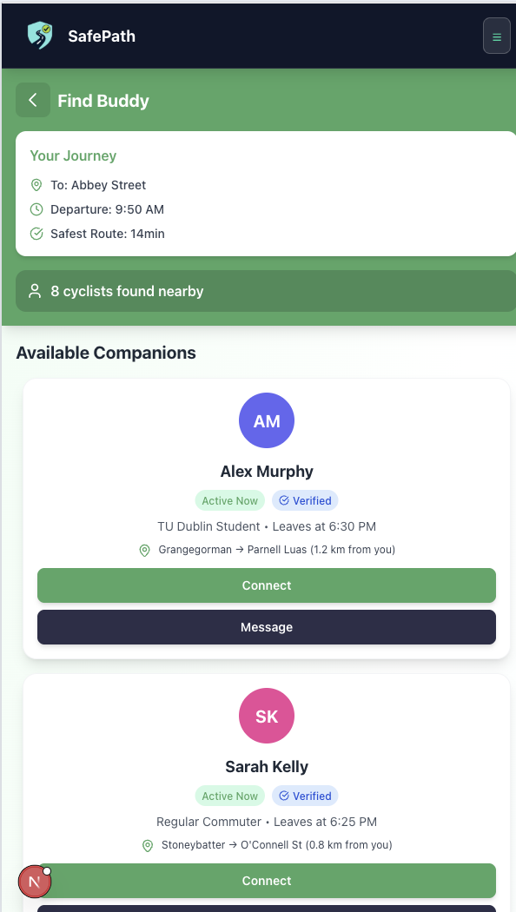
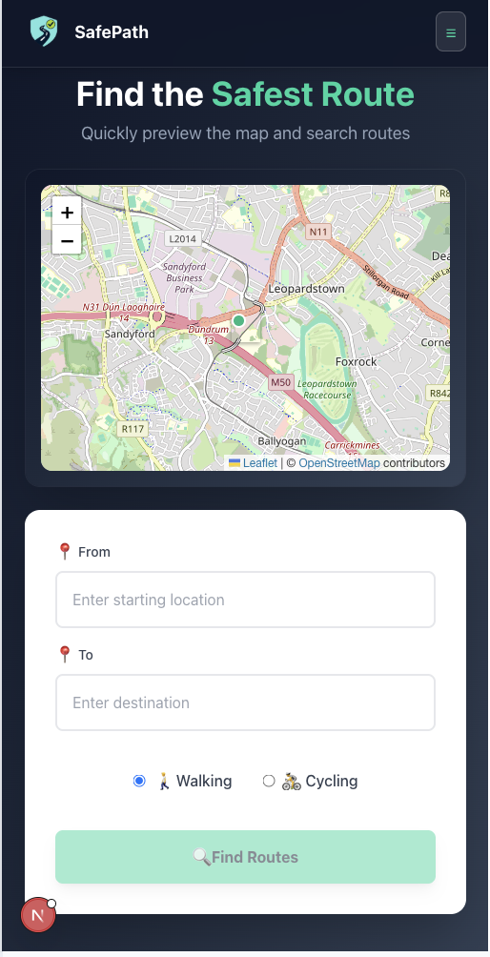
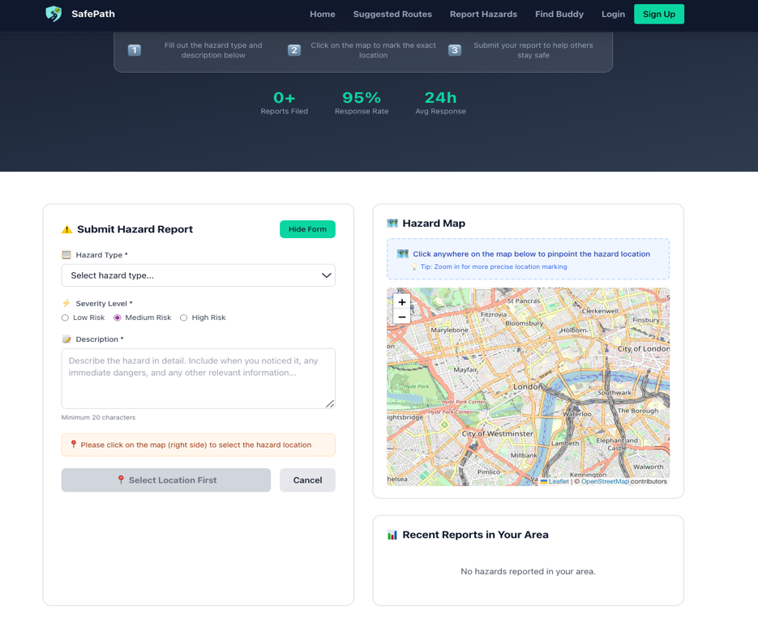
Final Application

Slide 21
Logo Trials
Initial
Second
Final

Slide 22
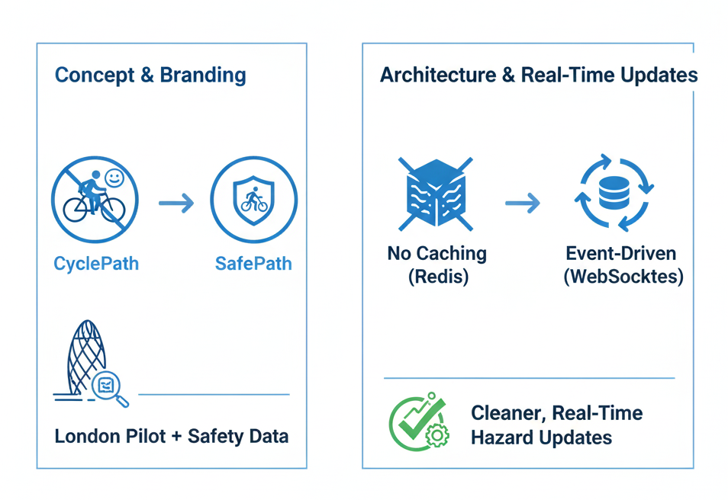
Expert Reviews – Key Changes from Mentor Feedback
Concept & Branding
Moved from CyclePath (only cyclists + social “Find Buddy”)
Rebranded to SafePath with a safety-first focus for both cyclists & pedestrians
Switched pilot city to London to use richer open police crime data
Architecture & Real-Time Updates
Dropped Redis caching (not needed for current scale)
Replaced DB triggers with event-driven WebSockets (Socket.IO)
Result: cleaner, more maintainable real-time hazard updates

Slide 23
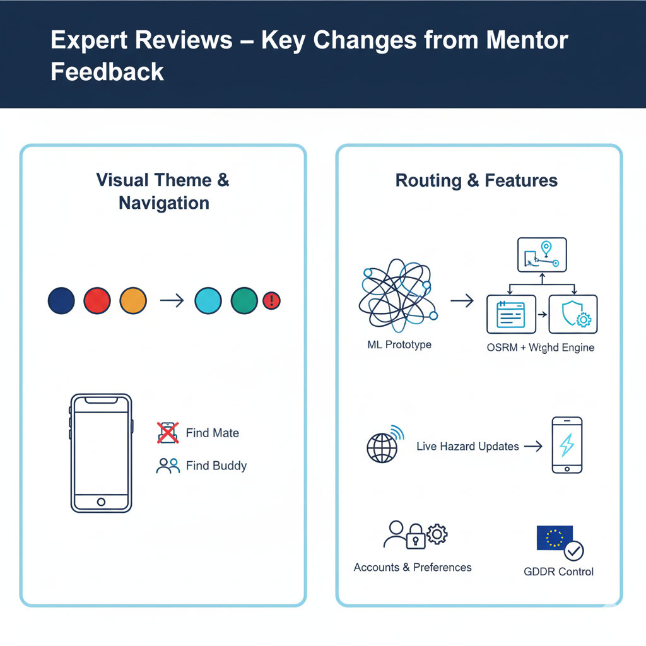
Expert Reviews – Key Changes from Mentor Feedback
Visual Theme & Navigation
Evolved from traffic-light map colours to navy + cyan, using red/amber only for critical alerts
Reduced clutter on home screen, moved main actions to top/bottom nav
Renamed “Find Mate” → “Find Buddy” to match safety/community framing
Routing & Features
Pivoted from complex ML prototype to transparent rule-based safety engine
Uses UK crime CSVs, risk per grid cell, OSRM routes + user safety weights
Reworked hazard reporting to broadcast live updates via WebSockets
Introduced accounts & profiles to store personalised safety preferences and support GDPR-friendly control

Slide 24
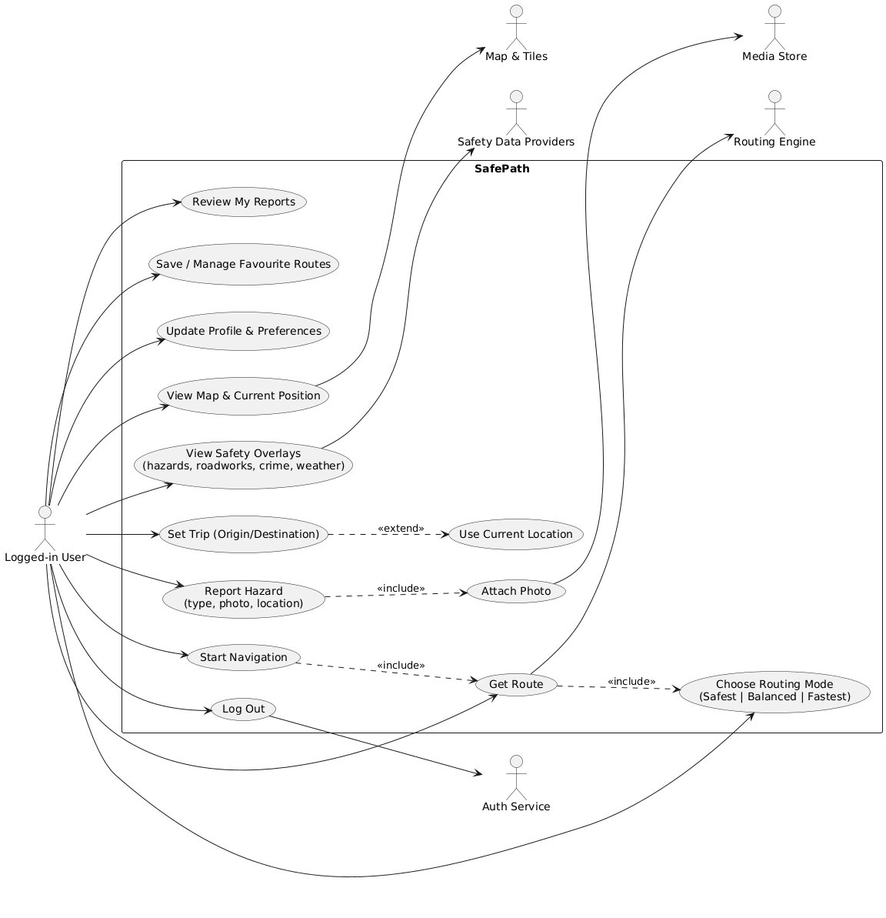
SafePath Use Case

Slide 25
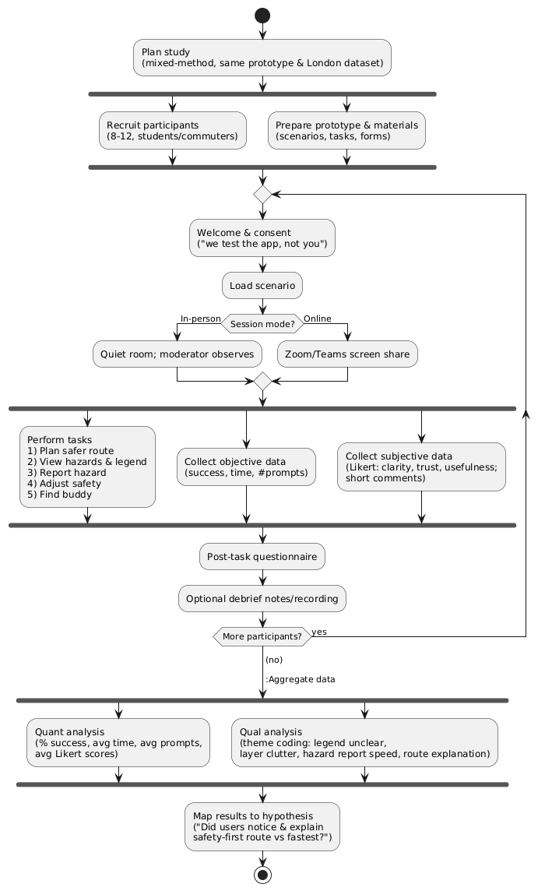
Experimental Setup

Slide 26
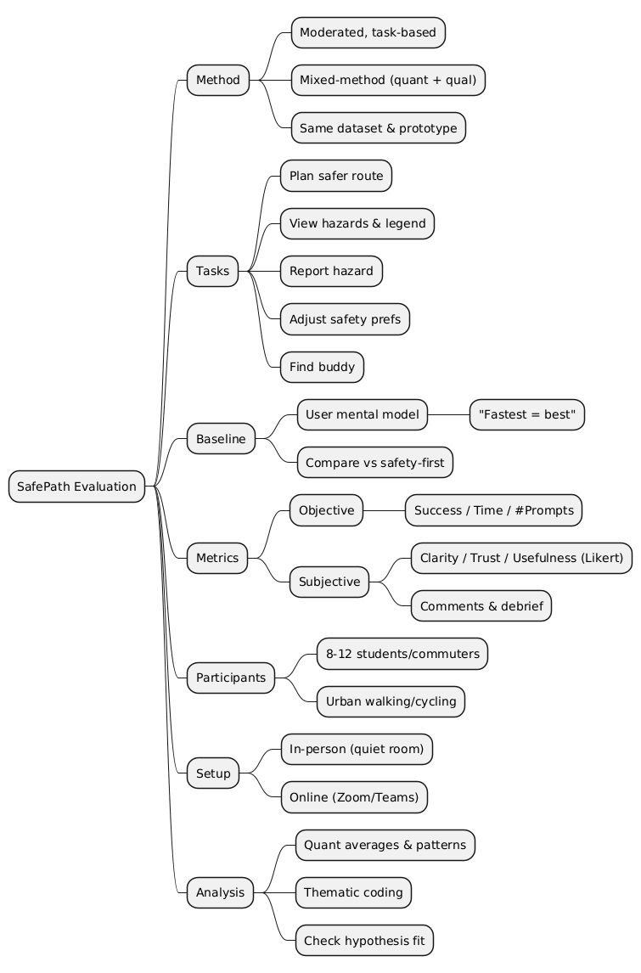
Evaluation Structure – Mind map

Slide 27
Q & A
Thank you

